Slide 1
Capstone Project
Olympics

Slide 2
Overview:
Games Analysis: The Historical Analysis centres on the comprehensive examination of past editions of the Olympic Games, providing crucial details such as the year, host country, and the type of event. This analysis empowers researchers to investigate the progression of the Games over the years, discern trends in host city selection, and analyze the various factors that have influenced the choice of host locations and the frequency of the Games.
Sports Analysis: The Sports Analysis allows researchers to explore the distinct sports disciplines showcased in the Olympics. It provides valuable insights into the varying popularity of these sports, participation rates, and the evolution of the sports included in the Games throughout different editions. By comprehending the unique characteristics of each sport, stakeholders can make informed decisions about the future sporting events of the Games.
Event Analysis: The Event Analysis focuses on delving into the specific events within various sports disciplines. Researchers can scrutinize event schedules, trace historical results, and assess the participation and achievements of athletes in these events. This analysis facilitates a more profound comprehension of the importance of individual events and their influence on the broader Olympic experience.
Participants Analysis: The Participants Analysis furnishes valuable insights into the individuals engaged in the Olympic Games, encompassing athletes, coaches, and other relevant figures. This analysis allows researchers to delve into the demographics of participants, the countries they represent, and the performance of athletes. It serves as a tool for identifying outstanding athletes, recognizing their accomplishments, and appreciating the global diversity of participants in the Olympics.
Medal Analysis: The Medal Analysis is dedicated to the examination of how medals are distributed among athletes and countries in different Olympic editions. It allows researchers to scrutinize medal counts, analyze patterns of medal achievement, and pinpoint the leading nations in various sports. This analysis offers valuable perspectives into the competitive dynamics of the Olympic Games and the sporting excellence of participating countries.
Regional Analysis: The Regional Analysis places a strong focus on assessing the involvement of National Olympic Committees (NOCs) and their respective regions in the Olympic Games. This examination of regional participation and medal achievements offers researchers a valuable opportunity to delve into the performance of regions across the globe. Through this analysis, we gain insight into the worldwide influence of the Olympics and honour the achievements of a wide array of nations.

Slide 3
Overview:
Game Analysis
Sports Analysis
Event Analysis
Participants Analysis
Medals Analysis
Regional Analysis

Slide 4
Objective
The analysis scope encompasses a comprehensive examination of the Olympics database, covering data from multiple editions of the Olympic Games. It includes analyzing records related to games editions, sports disciplines, individual events, participants' information, medal outcomes, and the representation of different regions worldwide.
Analysis Scope
The primary goal of this analysis is to provide a detailed overview of the Olympic Games historical data. By conducting extensive research and exploration, the aim is to identify trends, patterns, and significant insights from different aspects of the Games. The analysis seeks to present a cohesive narrative that showcases the rich history and evolution of the Olympics. Games
Goal
The objective of analyzing the Olympics database is to gain valuable insights into the historical data of the Olympic Games. This analysis aims to explore various dimensions, including games, sports, events, participants, medals, and regional representation, to understand the evolution of the Games and extract meaningful patterns from the data.

Slide 5
Insights
Insights from the data, such as identifying trends in host cities, evaluating the popularity and evolution of sports disciplines, recognizing outstanding athletes' achievements, and assessing the performance of regions and countries. Based on these insights, recommendations can be made to enhance future Olympic Games' organization, sports selection, and representation of diverse regions.
Conclusion
In conclusion, the analysis of the Olympics database aims to unravel the rich historical data of the Games, drawing meaningful insights, and providing recommendations to enhance the Olympics' future editions. Through a comprehensive report and presentation, the analysis will contribute to a deeper understanding and appreciation of the world's premier sporting event.to enhance
Presentation
The final deliverable will be a comprehensive report and presentation that presents the findings of the Olympics database analysis. The report will include detailed visualizations, statistical analyses, and data-driven insights from the various dimensions explored. The presentation will provide an engaging overview of the key findings, showcasing the historical significance and impact of the Olympic Games over time.

Slide 6
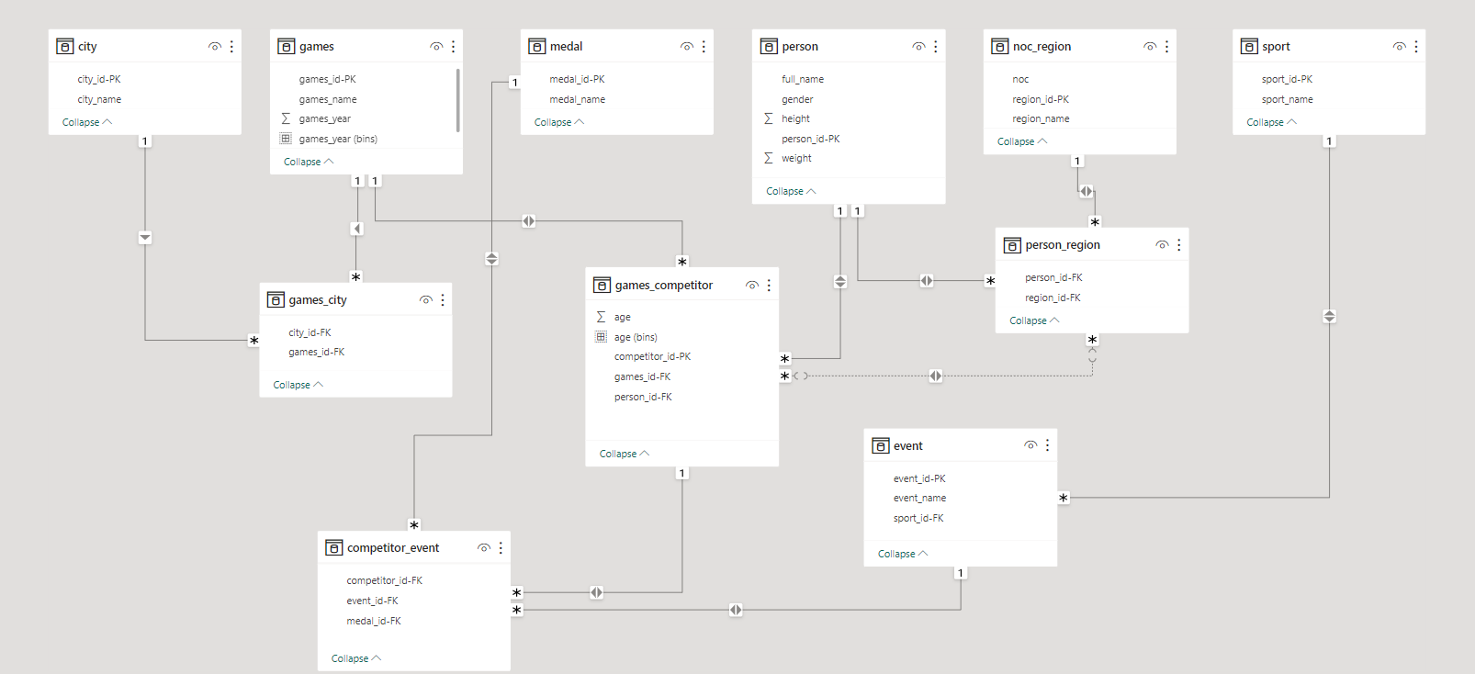
ER Diagram:

Slide 7
Power BI
Problem Statements

Slide 8
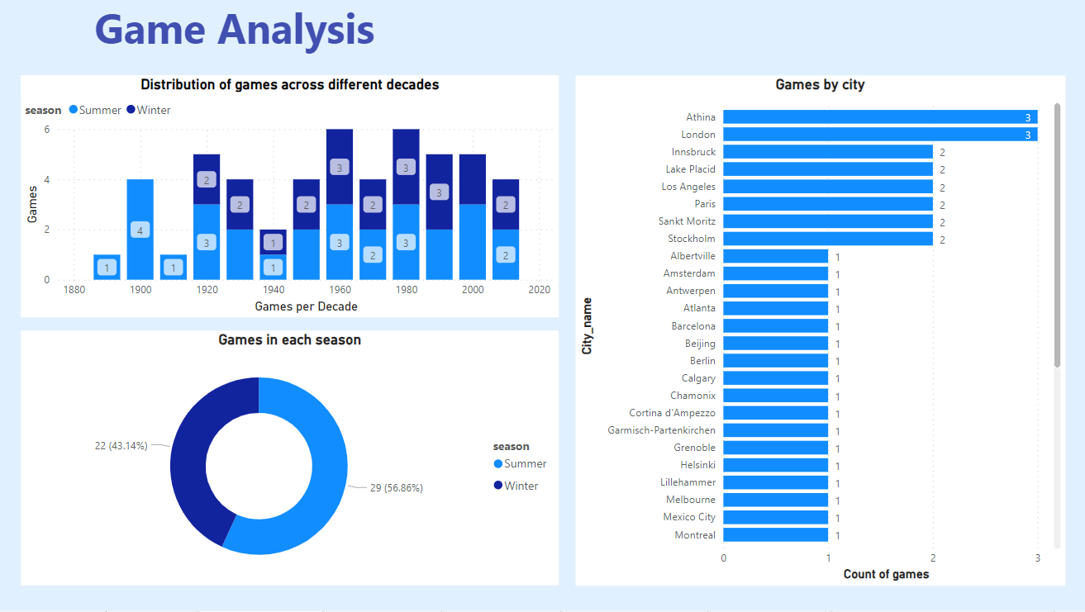

Slide 9
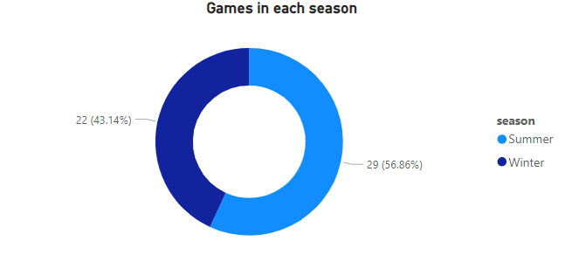
How many Olympic Games have been held in each season (Summer vs. Winter)?
From the visualisation we can see that most games are in summer season i.e. 29(56.86%) ,whereas in winter season we have 22(43.14%).

Slide 10
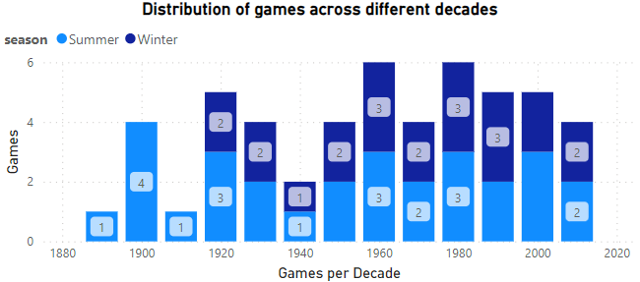
What is the distribution of games across different decades?
From the visualisation we can see that no. of games in each decade changes.

Slide 11
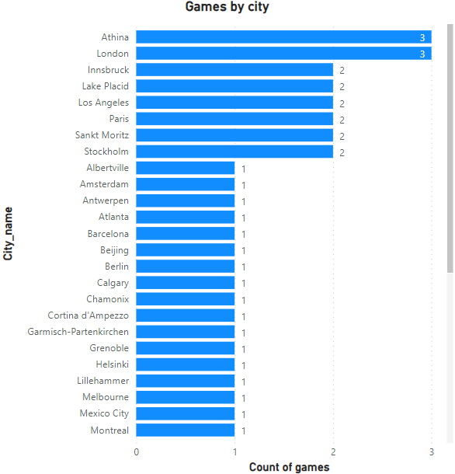
Which cities have hosted the most Olympic Games?
Athina and London hosted the most games i.e. 3 games.

Slide 12
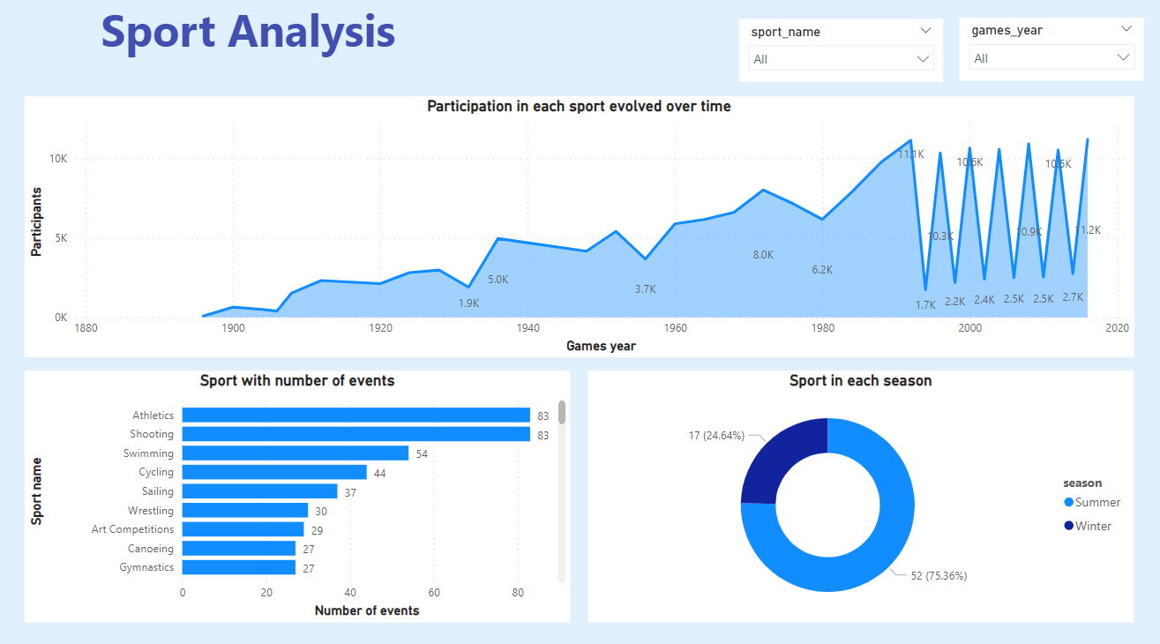

Slide 13
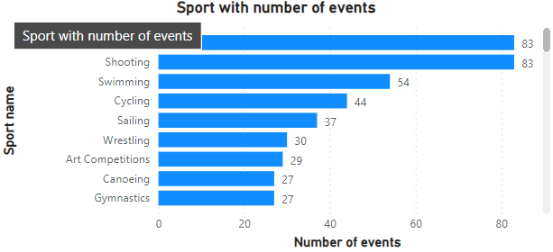
Which sports have the highest number of events in the Olympics?
Athletics and Shooting has the highest no. of events i.e. 83 events.

Slide 14
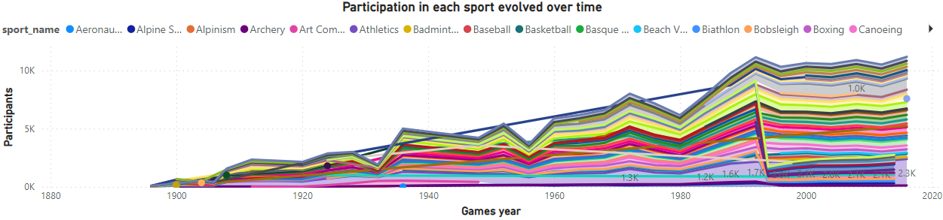
How has the participation in each sport evolved over time?
Using the sport_game slicer, we can see the participation of each sport over time.

Slide 15
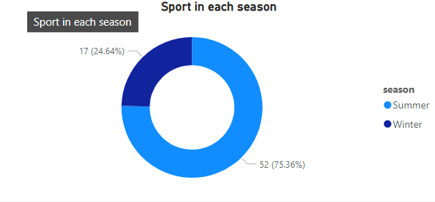
What is the distribution of sports between Summer and Winter Olympics?
From the visualisation, we can see that summer has 52(75.36%) sports and winter has 17(24.64%) sports.

Slide 16
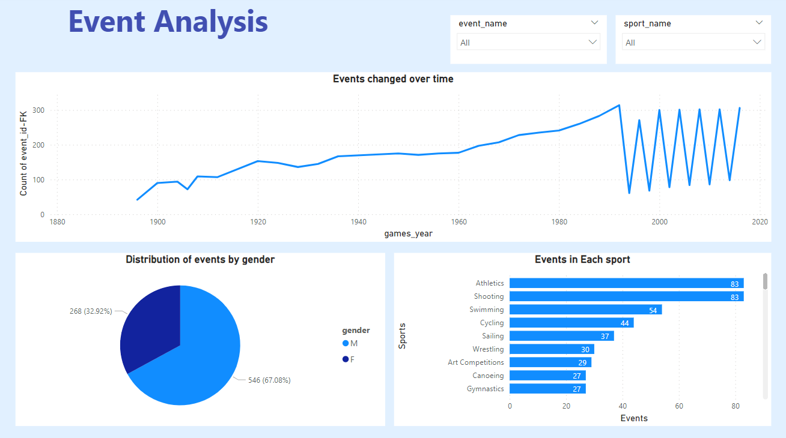

Slide 17
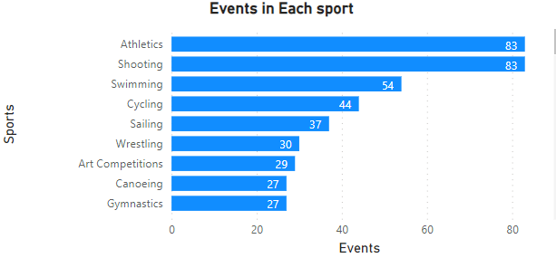
How many events are there in each sport?
Using the sport_game slicer, we can see the no. of events in each sport.

Slide 18
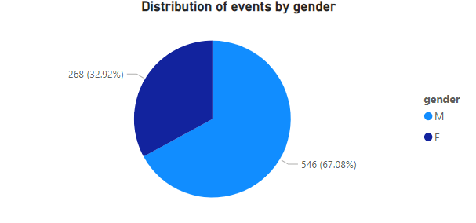
What is the distribution of events by gender (Men, Women, Mixed)?
Using the sport_game slicer, we can see the distribution of gender in each sport.

Slide 19
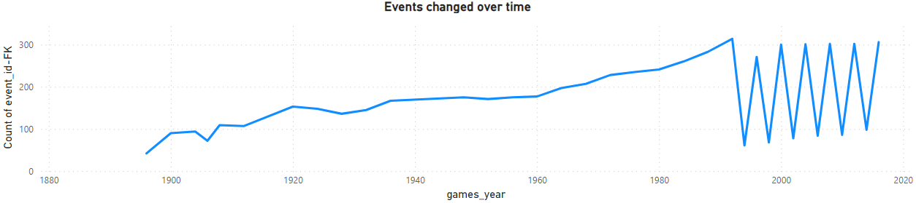
How has the number of events changed over time?
Using the sport_game slicer, we can see the no. of events change in each sport overtime.

Slide 20
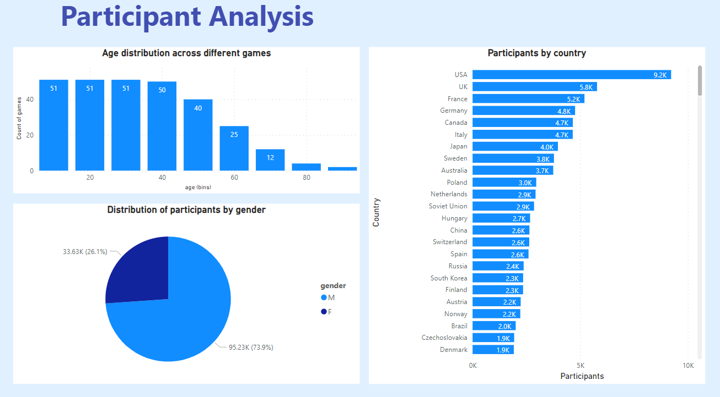

Slide 21
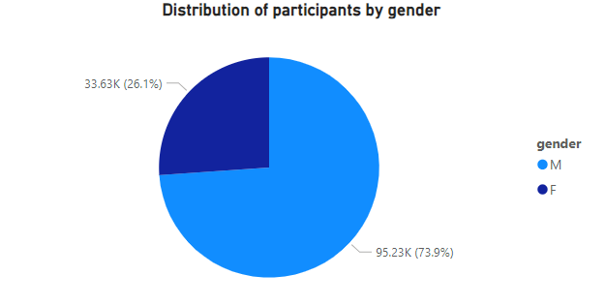
What is the distribution of participants by gender?
We can see from the visualisation that male participants are dominant with 95.23k(73.9%) and female participants 33.6k(26.1%).

Slide 22
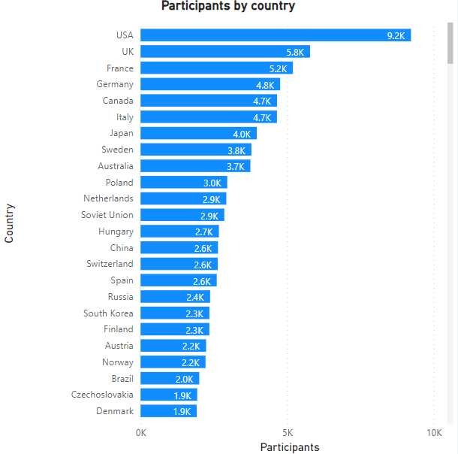
Which countries have the highest number of participants in the Olympics?
USA has the highest no. of participants with around 9.2k.

Slide 23
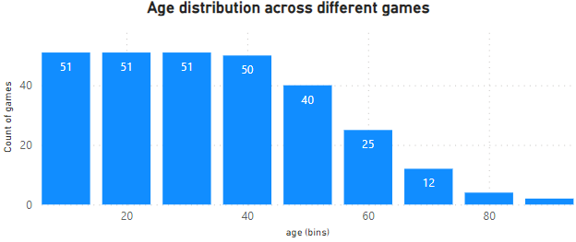
How does the age distribution of participants vary across different games?
Using the visualisation, we can analyse it.

Slide 24
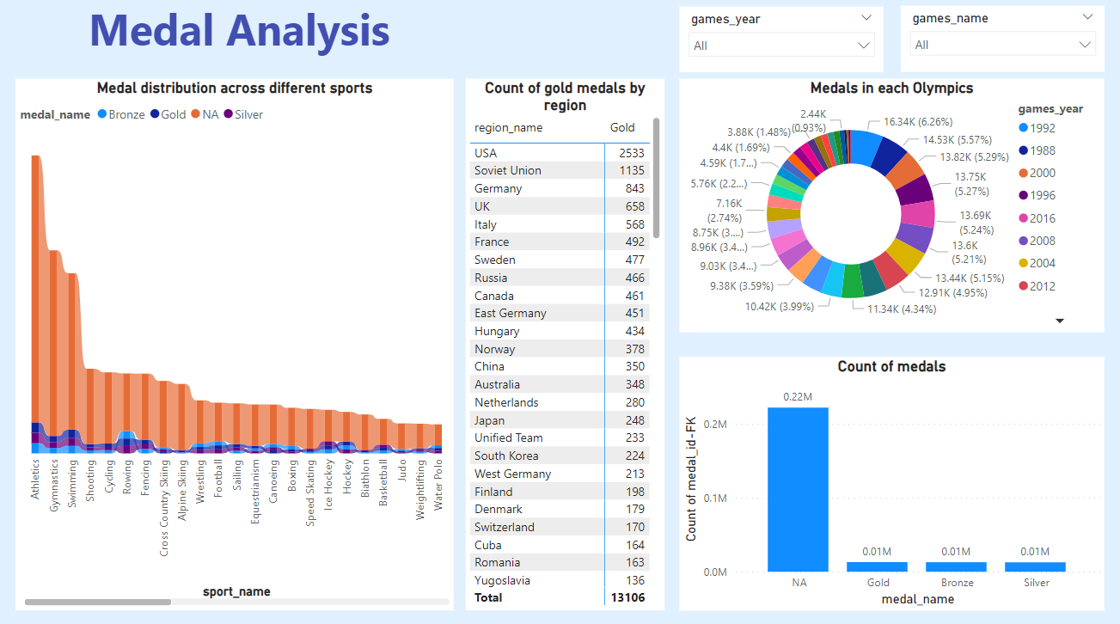

Slide 25
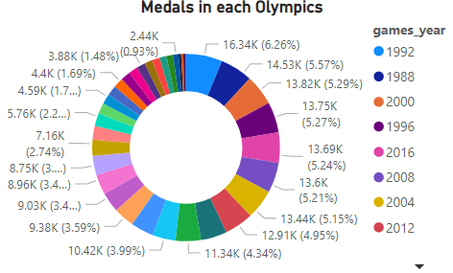
How many medals have been awarded in each Olympics?
Using the game_year slicer, we can see no. of medals awarded in each sport that year.

Slide 26
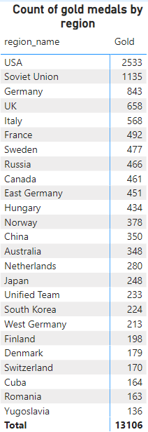
Which countries have the highest number of gold medals?
USA is the country with most gold medals i.e. 2533 golds.

Slide 27
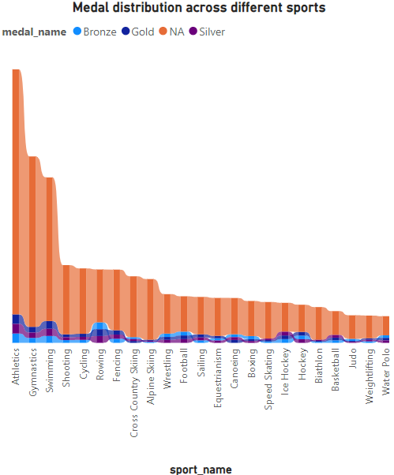
How does the medal distribution vary across different sports?
Using the game_year slicer, we can see the distribution of medals in every sport that year.

Slide 28
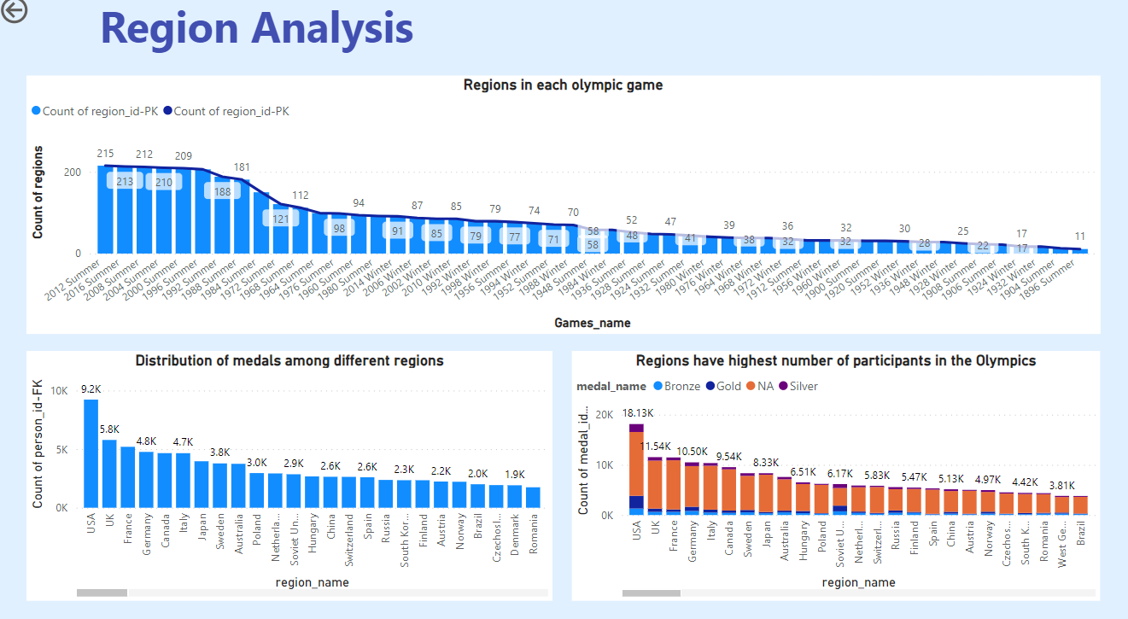

Slide 29
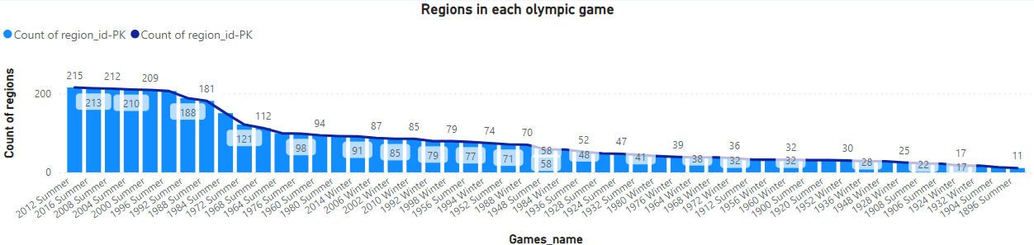
How many regions or NOCs participate in each Olympic Games?
From the visualisation, we can analyse the count of regions in each Olympic games.

Slide 30
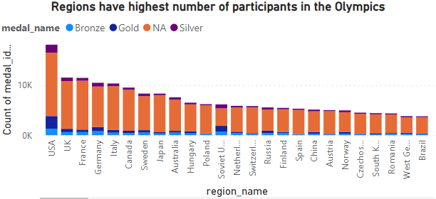
Which regions have the highest number of participants in the Olympics?
USA has the highest no. of participants.

Slide 31
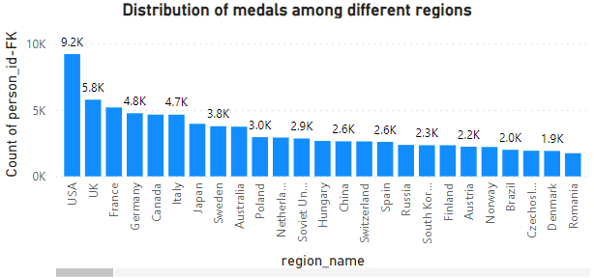
What is the distribution of medals among different regions?
From visualisation, we can the distribution of medals for each region.

Slide 32
EDA
Problem Statements

Slide 33
Are there any trends or patterns in the frequency of hosting the Olympic Games?
Yes ,we can see a trend in frequency of hosting olympic games.

Slide 34
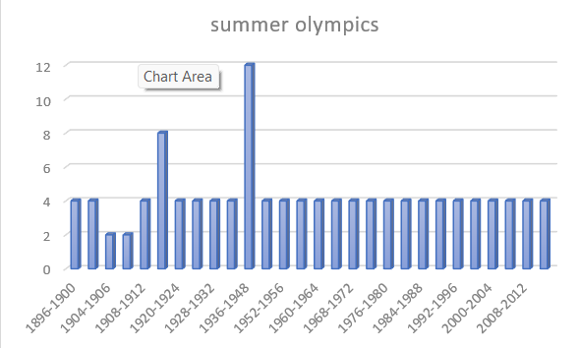
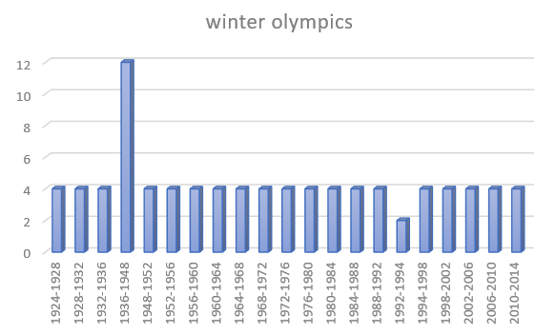
How has the duration of the Olympic Games changed over time?

Slide 35
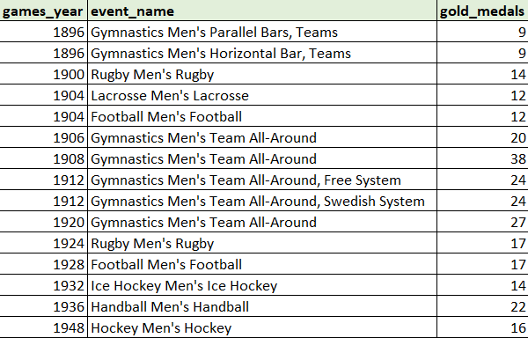
Are there any notable events or occurrences associated with specific Olympic Games?
Yes, there are noticeable events. Noticeable event is the event that has won the highest no. of gold medals in that specific Olympic game.

Slide 36

Are there any emerging sports that have been recently added to the Olympics?
Yes, Rugby sevens is the sport that have been added recently in year 2016.

Slide 37
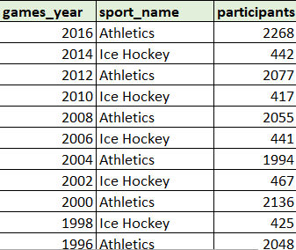
How has the popularity of certain sports changed over the years?
I have calculated popularity by calculating the highest no. of athletes participating in sport in each Olympic game. So in this way, I get the most popular sport of each game.

Slide 38
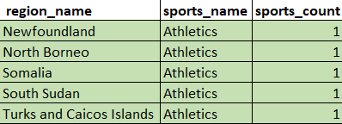
Are there any sports that are specific to a particular region or culture?
Yes, there are sports that are specific to a particular region or culture. We can see that Athletics is the only sport in 5 regions.

Slide 39
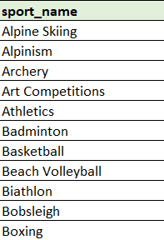
Are there any sports that have a higher number of events for one gender compared to others?
Yes, 49 sports have a higher number of events for one gender compared to others. To calculate this, firstly I have calculated events for both genders acc. to their sport and then I have filtered out sports by removing those sports that have 0 events for one gender, from I get only those sports that have events for both genders. Later I filtered out sports where events are not the same.

Slide 40
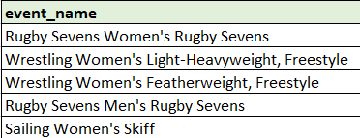
Are there any new events that have been introduced in recent editions of the Olympics?
In the most recent edition i.e. 2016, 5 new events were introduced.

Slide 41
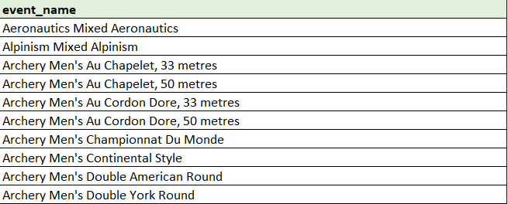
Are there any events that have been discontinued or removed from the Olympics?
Yes, multiple events were discontinued or removed from the latest Winter (2014) and Summer (2016) Olympic games. Here is the list of 353 events that are removed.

Slide 42
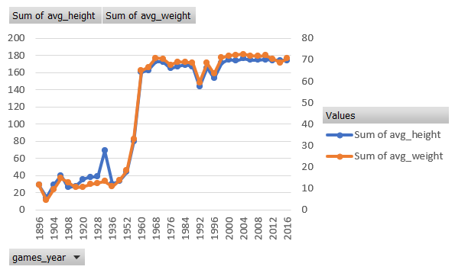
Are there any notable trends in the height and weight of participants over time?
Yes, there is a trend in the average height and average weight of participants over time in the Olympics.

Slide 43
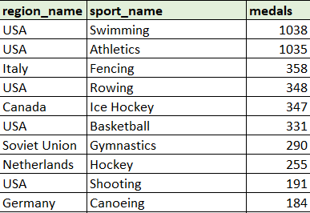
Are there any dominant countries or regions in specific sports or events?
Yes, there are dominant countries in specific sports. I have calculated dominant sport by calculating medals by region on specific sport then filtering out the with most medals in specific sport.

Slide 44
What factors contribute to the success or performance of participants from different countries?
There is no relevant data provided to get to know the factors that contribute to the success of participants in the Olympic games but following my research, the factors I found are :
Financial Support
Infrastructure
Coaching and Sports Science
Government Policies
Athletes support system
Diet and nutrition
Healthcare

Slide 45
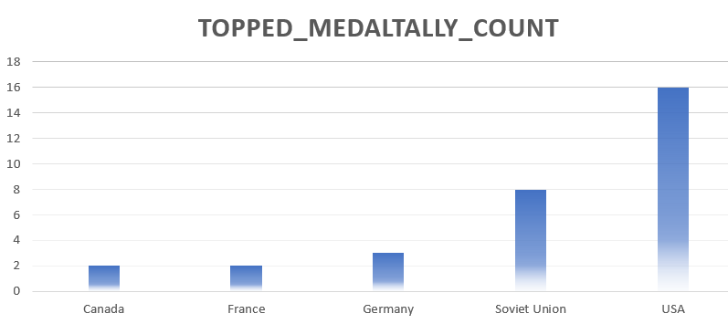
Are there any countries that consistently perform well in multiple Olympic editions?
Yes, there are 5 countries and USA is the most consistent one.

Slide 46
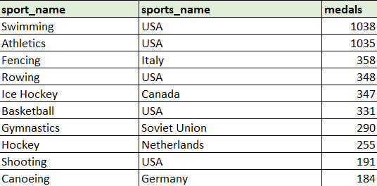
Are there any sports or events that have a higher number of medalists from a specific region?
Yes, some sports have a higher number of medalists from a specific region.

Slide 47
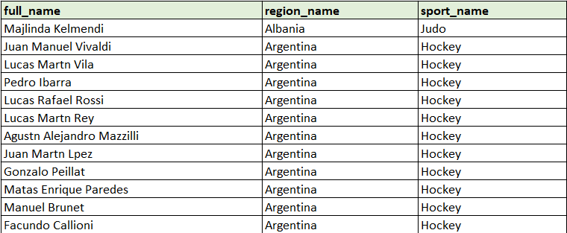
What are some notable instances of unexpected or surprising medal wins?
To calculate notable instances of unexpected or surprising medal wins of each Olympic game is difficult to calculate as there is not proper or relevant data given. So to do this I have compared the unexpected medal win of a year to the previous year. Here first of all I have filtered the participants who were not able to win any medals in year 2010(winter) and 2012(summer) games. Later on, I put this in a sub-query and filtered the participants from this sub-query who were able to win a gold medal in 2014(winter) and 2016 summer.

Slide 48
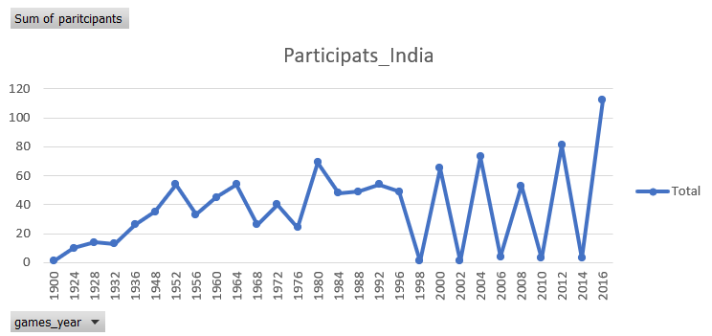
Are there any regions that have experienced significant growth or decline in Olympic participation?
Yes, there are multiple regions or I can say that approximately every region has shown significant growth in the Olympic games. To show the growth of every region is quite difficult. As there is no specific region mentioned in the question, here I take one region i.e. India as an example to visualize or solve the question.

Slide 49
How do cultural or geographical factors influence the performance of regions in specific sports?
There is no relevant data provided for this question but following my research and analysis the factors I analyzed are :
Cultural Significance
Training and Legacy
Access to Facilities and Terrain
Genetics and Body Types
Local Competition
Support Systems

Slide 50
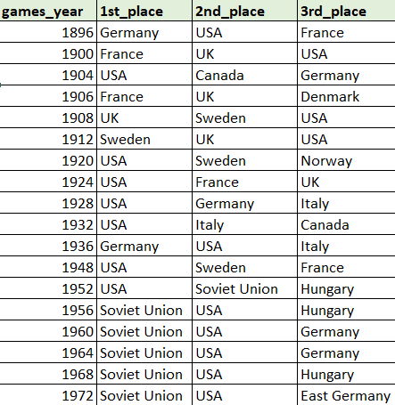
Are there any regions that have had a notable impact on the overall medal tally?
Yes, some regions have had a notable impact on the overall medal tally. To calculate this, I have taken the top 3 regions of each Olympic games according to the count of their medal tally.

Slide 51
Thank You ☺

